Slide 1
Insights on the effect of aircraft traffic on avian vocal activity
What are the effects of aircraft traffic on avian vocal activity at sites with differing aircraft traffic levels?
Vincelette, H., R. Buxton, N. Kleist, M. F. McKenna, D. Betchkal, and G. Wittemyer. 2021. Insights on the effect of aircraft traffic on avian vocal activity. Ibis 163:353–365.

Slide 2
Response Variable and Predictors
Response Variable
Bird audibility
Predictors
Aircraft noise
Jet
Helicopters
Propellor
Site location
Aircraft activity

Slide 3
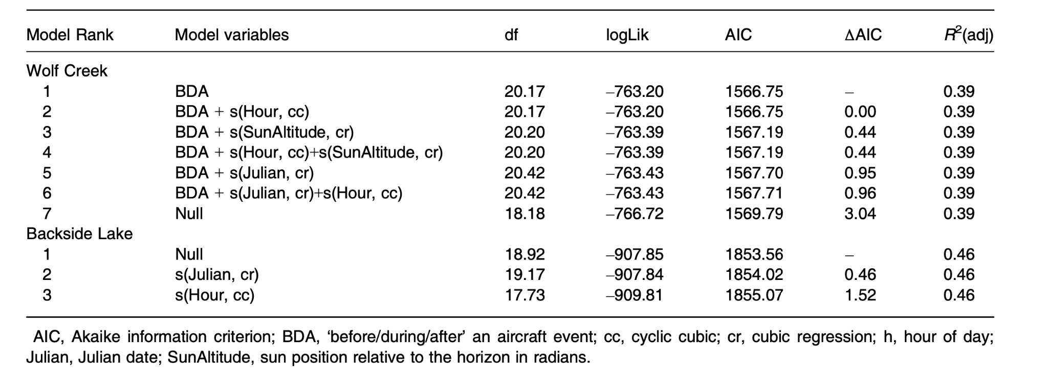
AIC Table

Slide 4
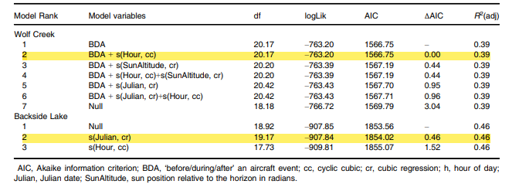
Important Models

Slide 5
Concluding Remarks
Bird vocalization richness increased after an aircraft passed over a site with lower aircraft activity.
Aircraft noise likely a driving factor for biodiversity loss.
Increases in air traffic present biodiversity loss as an ongoing issue.

